Slide 1
Results 11/10/24 Results 22+23/10/24
I will mix between these measurement days, since I will focus on the different topics in the analysis.

Slide 2
What was measured?
11/10/24: Array 128x0.5x0.5 mm²
y-translation through undiffused beam for normalisation under difficult circumstances?
Multiple pictures of undiffused beam, and the 3 diffusers with Gafchromic scans afterwards for comparison
New Bragg wedge out of PEEK material – combined with different energies from Al foil wheel
9 scans of undiffused beam over 1 hour
After second scan of beam there was a crash of the array into the metal parts of the proton outlet (likely to due tilt of stage from touched stage connction cables). We saw a saturated current, luckily there was NO! fatal damage to any diode or to the readout circuit. If some properties of either of those changed is of course not directly clear and will be investigated.

Slide 3
11/10/24: matrix 11x11 1x1 mm² #1
Voltage scans
x and y-translation to diffused beam
xy scan of beam to puzzle into one picture (with less time requirement than scan of linear array)
movie scan of beam (with fixed position, but several changes of the beam during the one long scan ~1500 frames over ~ 20 minutes)

Slide 4
21/10/24: matrix 11x11 0.5x0.5 mm² #1
Voltage scans + voltage dependent linearity
y-translated scan
xy scans of round aperture and star of misc shape with steps of half the diodes size for super-resolution
movie scan of beam over lunch (unchanged beam) + Gafchromic
scans of middle of undiffused beam at different proton energies from wheel (7 energies from 23.7 to 3.5 MeV) – what changes in terms of signal to noise ratio? What can we learn about our energy resolution?
y-translation after all these measurements
linearity afterwards
image of the misc star at the 7 chosen wheel positions – image quality in energy dependence
PEEK wedge for all 20 wheel positions with y-scan
21/10/24: array 2x64 0.5x0.5 mm² #1
PEEK wedge for all 20 wheel positions (stationary)

Slide 5
22/10/24: array 2x64 0.5x0.5 mm² #1
voltage scans
y-translation for normalization
linearity in voltage dependence
Gafchromic comparisons of: all three diffusers (40, 200, 400 um); logo, misc, PEEK wedge, mouse-foot, undiffused beam
22/10/24: matrix 11x11 1x1 mm² #2
voltage scans
y-translation for normalization
movie of beam over lunch
movie with increased current (increase each 30 seconds, ~1fps, from 100 pA to 2 nA)
linearity test, voltage dependent
another 2 movies of undiffused beam with some live changed features
movie of the moved logo (sadly with some problems due to improvised change of the stage translation – more details later – but at least we filmed the crash of the stage)

Slide 6
Strange 50 Hz modulation only with diffuser

Slide 7
Some important remark
During the measurements with lower integration time with higher frame rate I observed some periodic pattern on the signal with samples) meaning on the time axis!
I observed this more in detail, and will continue to make comparisons for all measurement days.

Slide 8
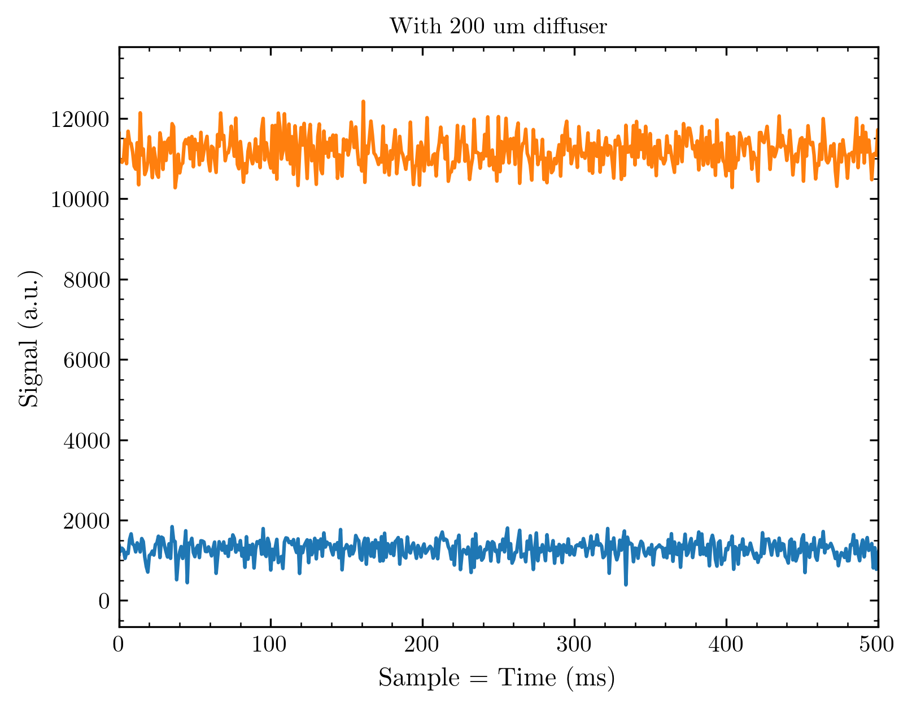
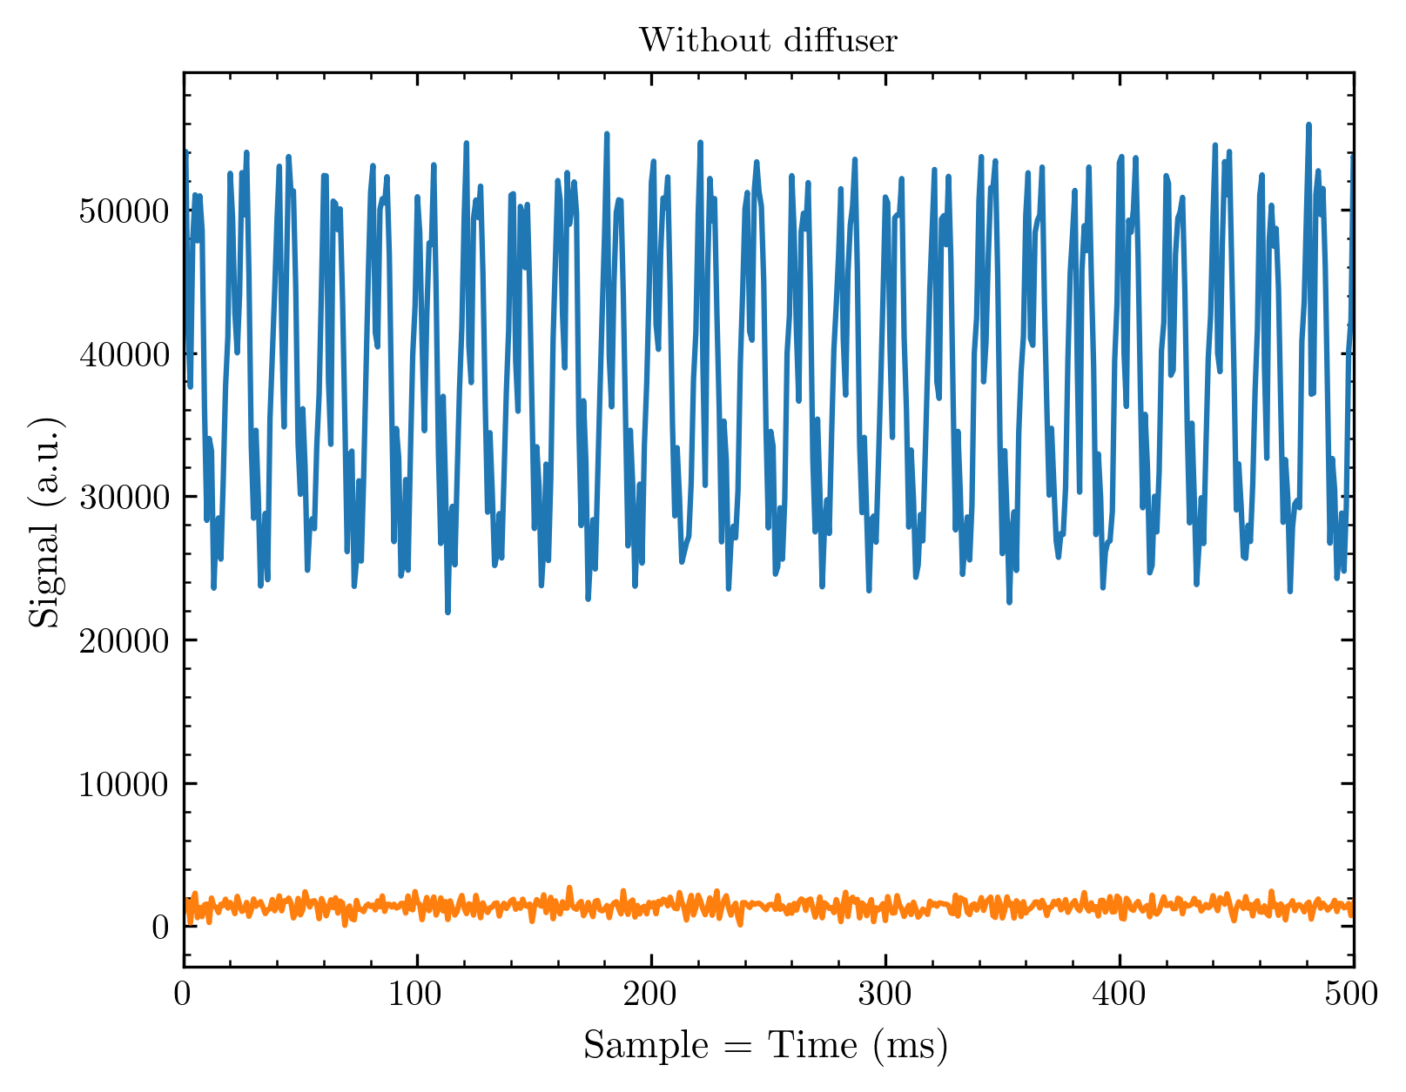
50 Hz noise on undiffused beam?!
Compared is the highest and lowest (dark) signal of arbitrary measurements with and without diffuser
I observed this modulation for different measurement days whenever we measured without diffuser; I will nevertheless bring these observations in plots for you to compare
If you count the periods on the right side you find: 10 periods in 200 ms meaning 50 in 1s = 50 Hz…

Slide 9
Where could this come from?
We first thought about the readout electronics, but this is not explaining why we observe only without diffuser
The Cyrcé guys thought about a pump and a mechanical vibration – it was not the cause and would also not explain the diffuser behaviour
Obviously the fact that the modulation disappears when the diffuser is in the beam is really odd
(I started the following thought: A diffuser should compensate for the time modulation of a proton beam because it changes the trajectories of incoming protons. You can continue the thought and if this would imply something for the undiffused proton beam at Cyrcé…)

Slide 10
New voltage scan results

Slide 11
Some remarks
I made some mistake with the results I have shown earlier for the 128 diode line arrays!
The problem was: I considered all diodes, but we only had a part of these arrays in the beam
Thus, I wrote a new routine for voltage scans (since this is part of our standard characterisation of arrays) with implemented filter for signal diodes (this also excludes not properly working diodes)

Slide 12
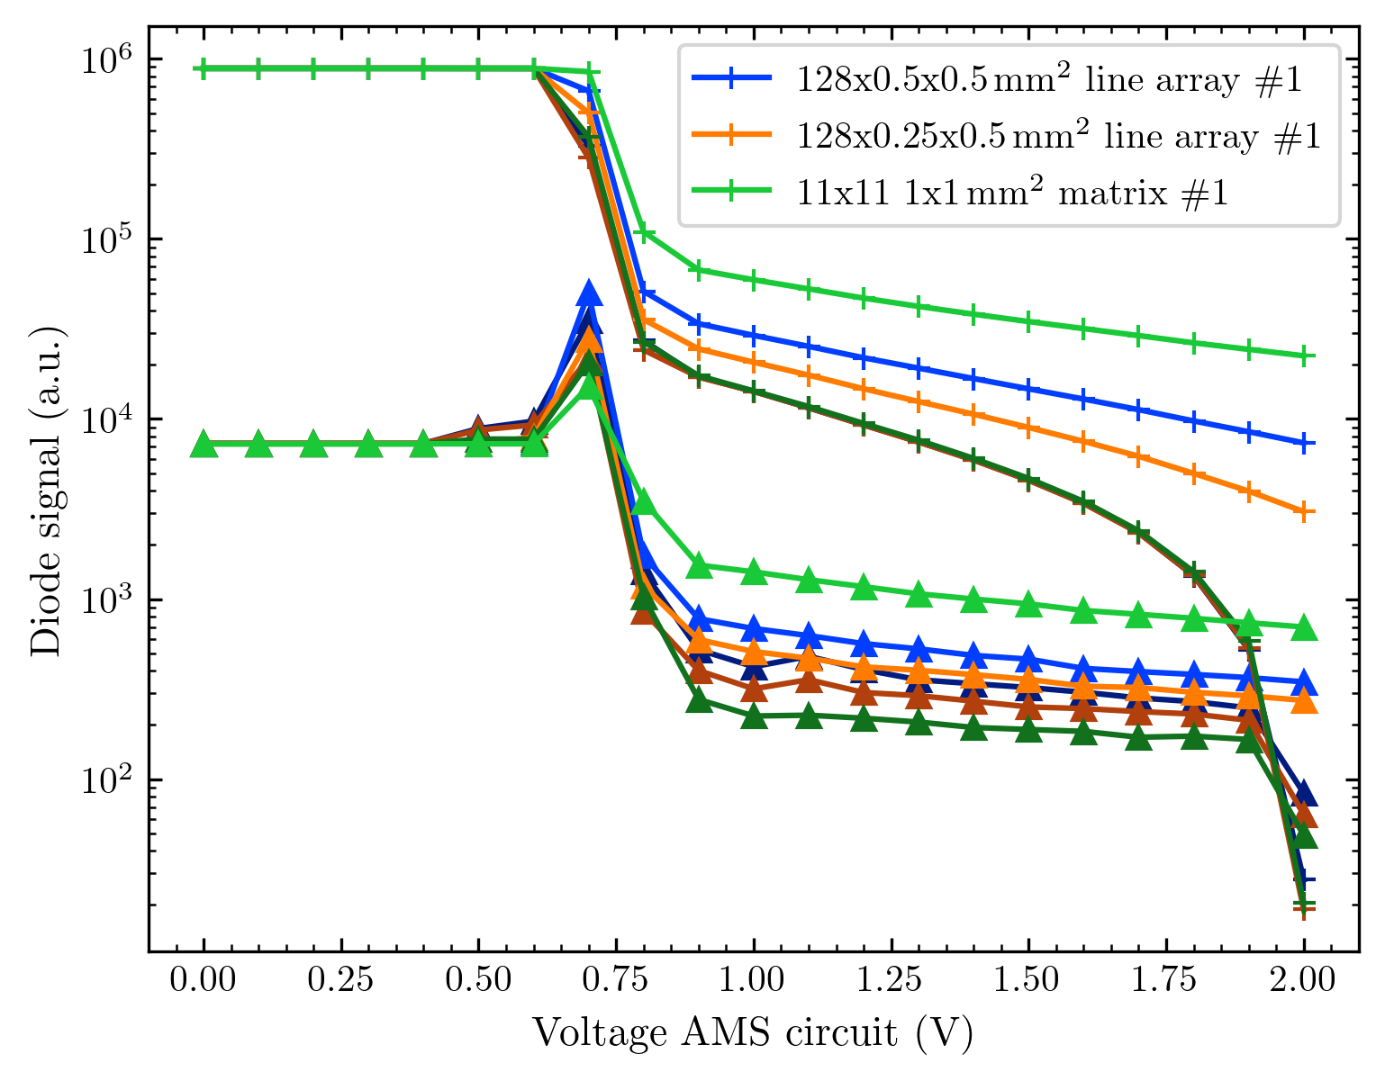
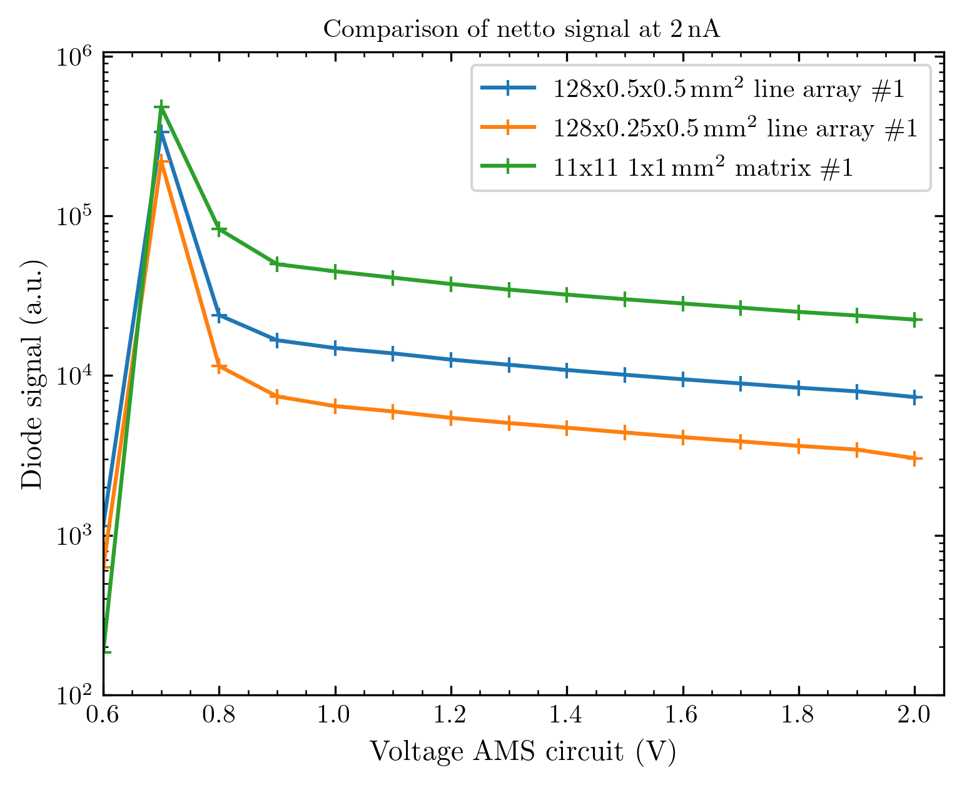
Voltage scan up to the 11th October

Slide 13
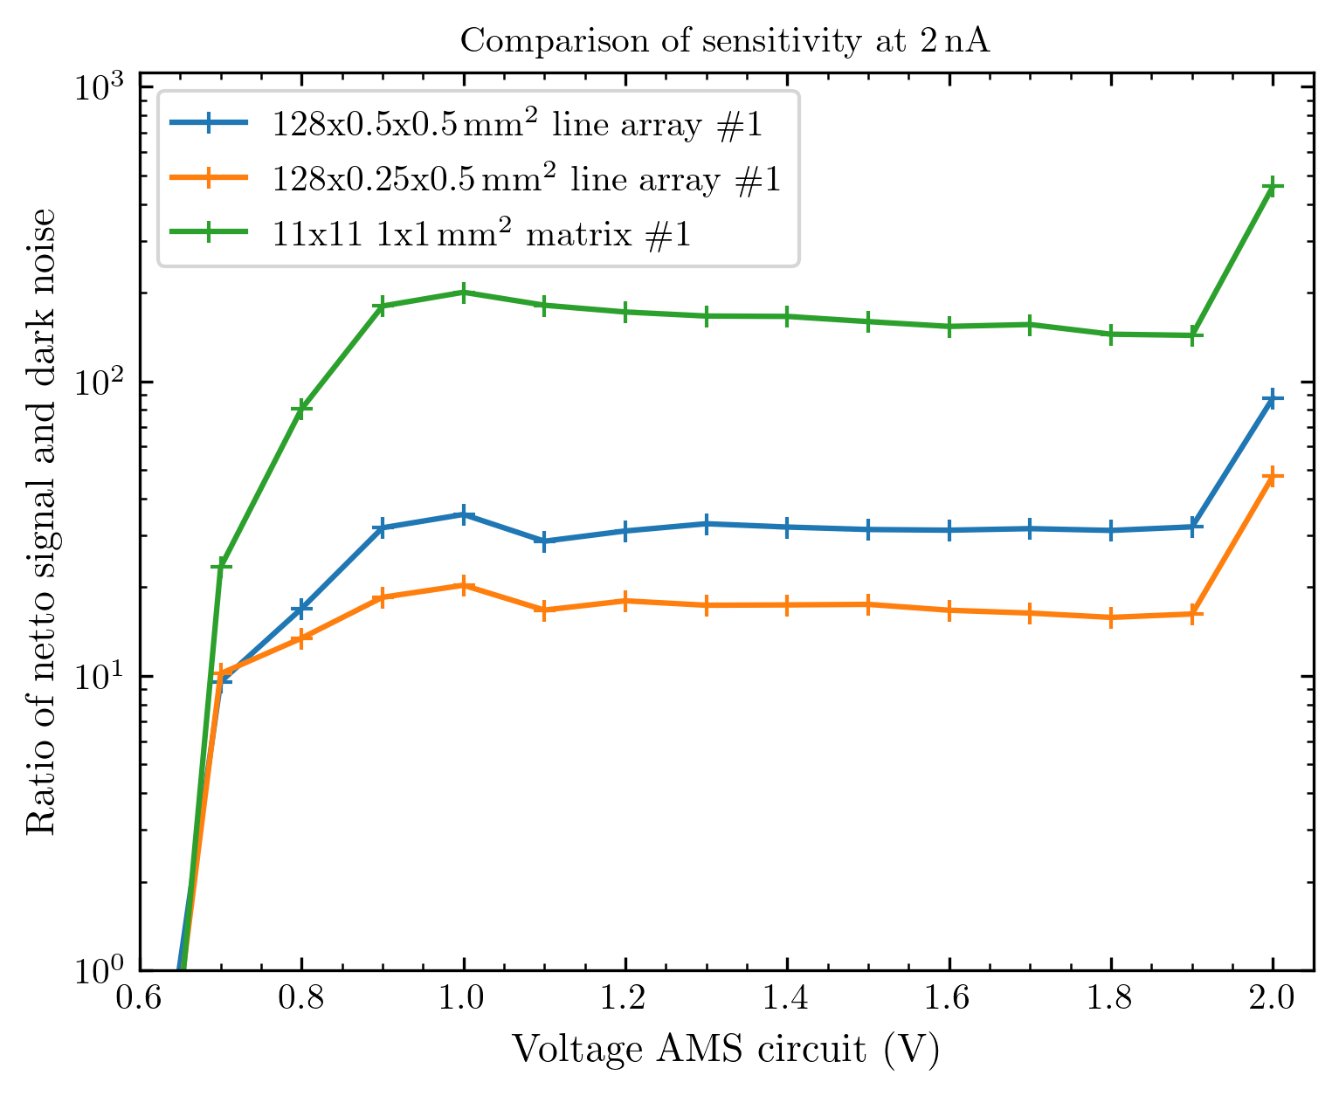
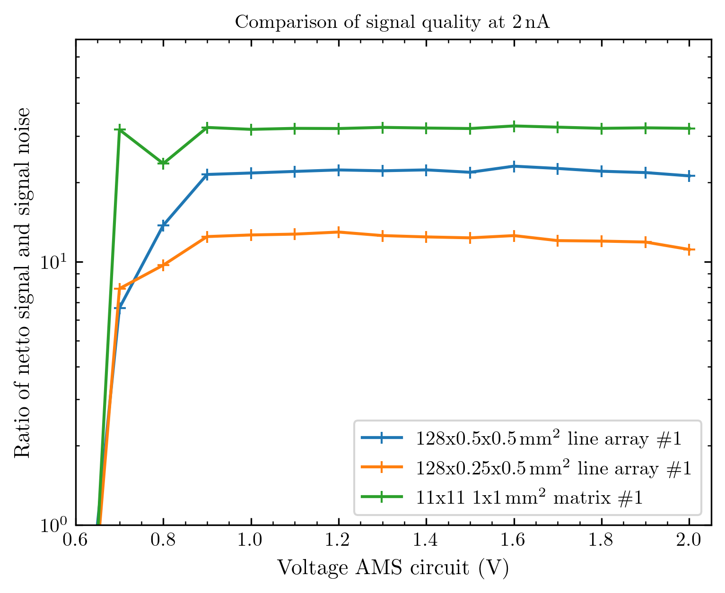
Sensitivity and signal quality

Slide 14
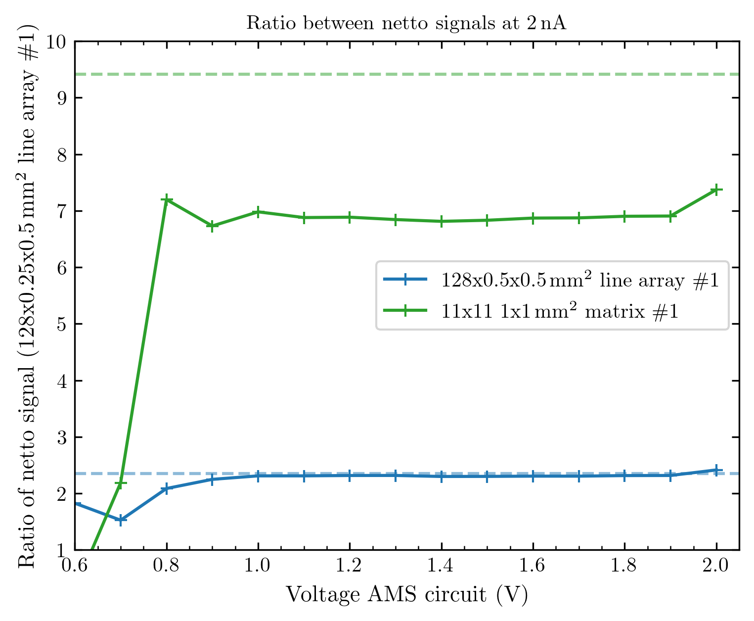
And most importantly the ratios!
These are the ratios normed to the smallest array (128x0.25x0.5)
A dashed line shows the caluclated ratio when considering the active region of the diodes (meaning 0.4 x 0.4 mm² for the 0.5 x 0.5mm² diodes)
These new results are remarkable and different from what I presented earlier. The new implication is: The detection seems to happen exactly in the region we intend it to happen!
For the matrix array, we observe a discrepancy from the estimated ratio, but I will explain later why this is not really comparable.

Slide 15
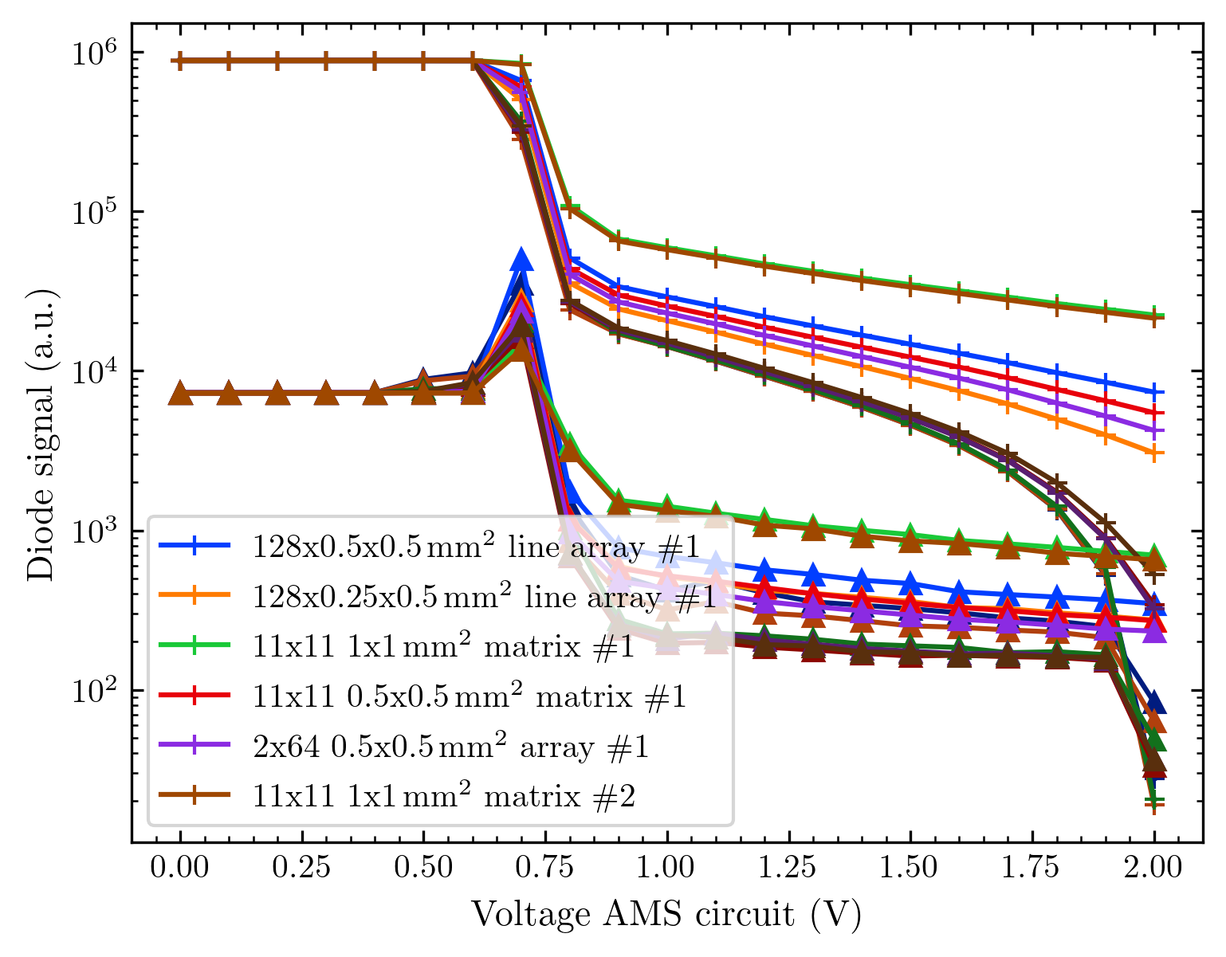
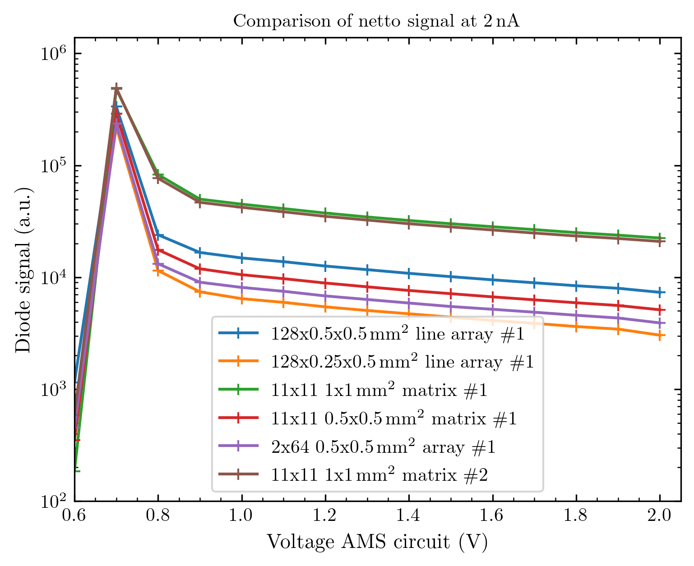
All voltage scans up to the 22nd of October

Slide 16
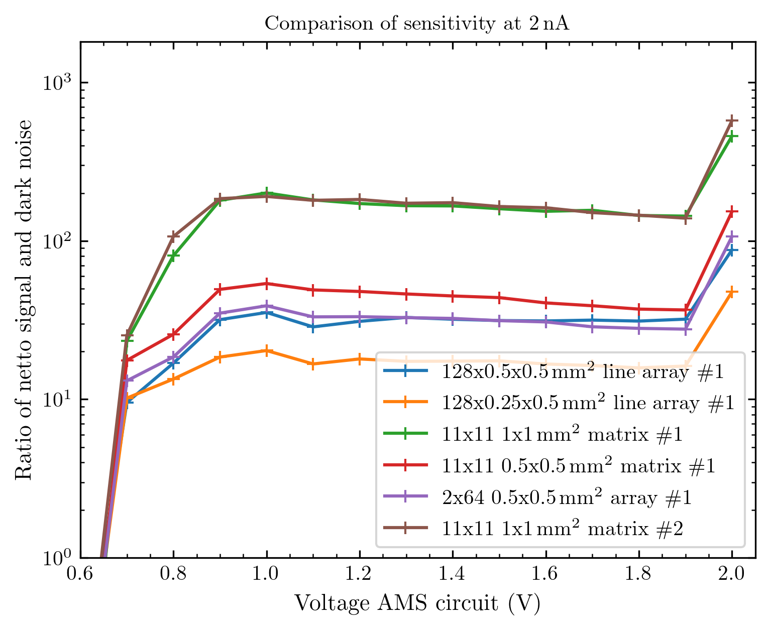
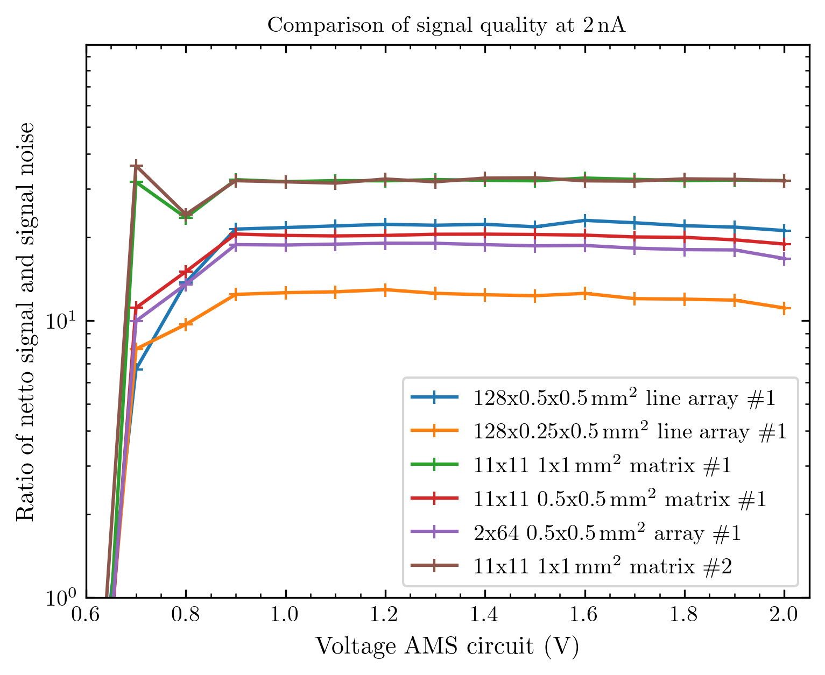
Sensitivity and signal quality
Note that the sensitivity implies that we could e.g. detect a current ~ 200 lower than we had for the big matrix arrays)
Meaning: 2 nA at Faraday cup / 200 = 10 pA at Faraday cup under these conditions for the large diodes.

Slide 17
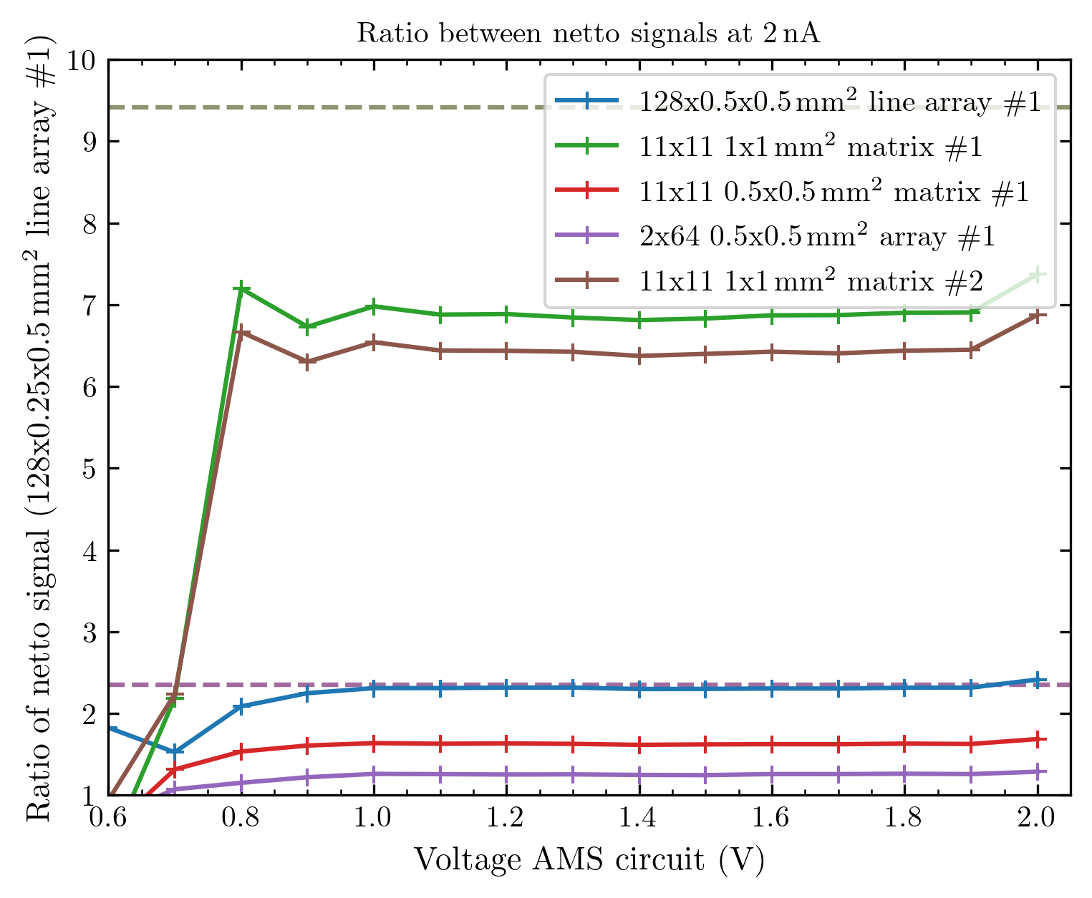
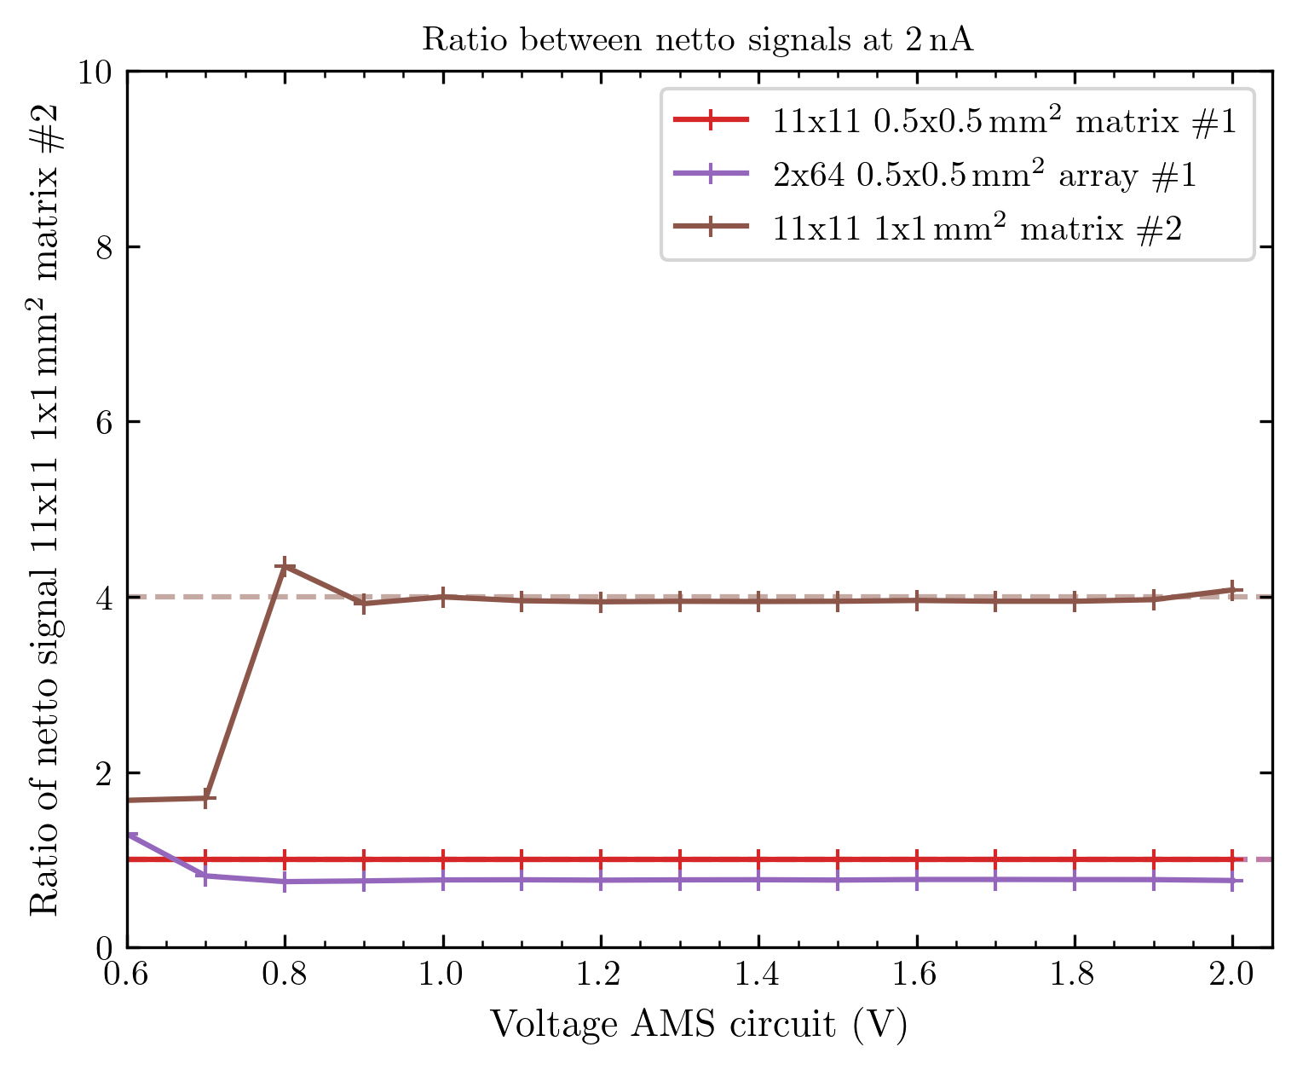
All ratios
All arrays normed to small 128x0.25x0.5 array, but conditions are not all comparable!
All new arrays from 21/22 = comparable, normed to small matrix.

Slide 18
Still not really correct
I wrote in the header of the plots @ 2 nA, but this is false
On the 23rd of September, we had 2.43 nA at Faraday cup to get 2 on the sample and the additional collimator
Afterwards, we kept 2 nA at the Faraday cup…
To make really correct plots, I need to correspond to the proton current we really had on each measurement day. So far, the info we got from the Cyrcé crew does not really fit, so I am waiting for further updates.

Slide 19
Movie time: logo and current increase
Speed by factor 20 increased to 20 fps.
If movies are not displayed correctly in PPT: I put them as .zip into the results folder

Slide 20
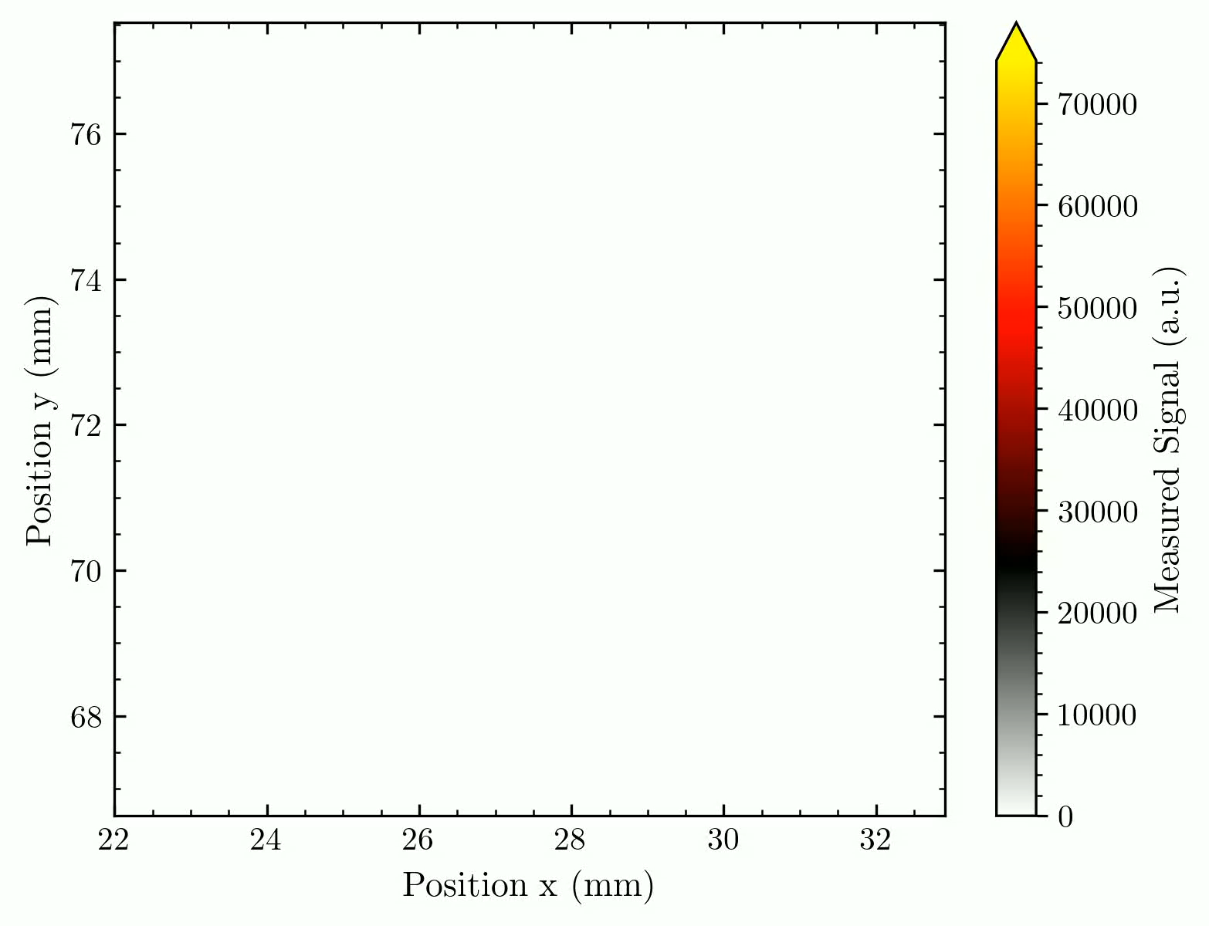
Movie current increase
Needs refinement, like normalisation and eventually filtering for uniform intensity scale
We used a square aperture shadowing the borders of the array.
The array is slightly tilted.

Slide 21
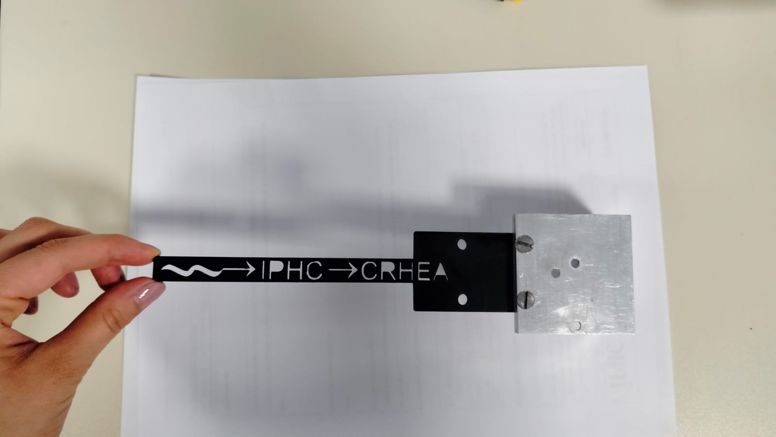
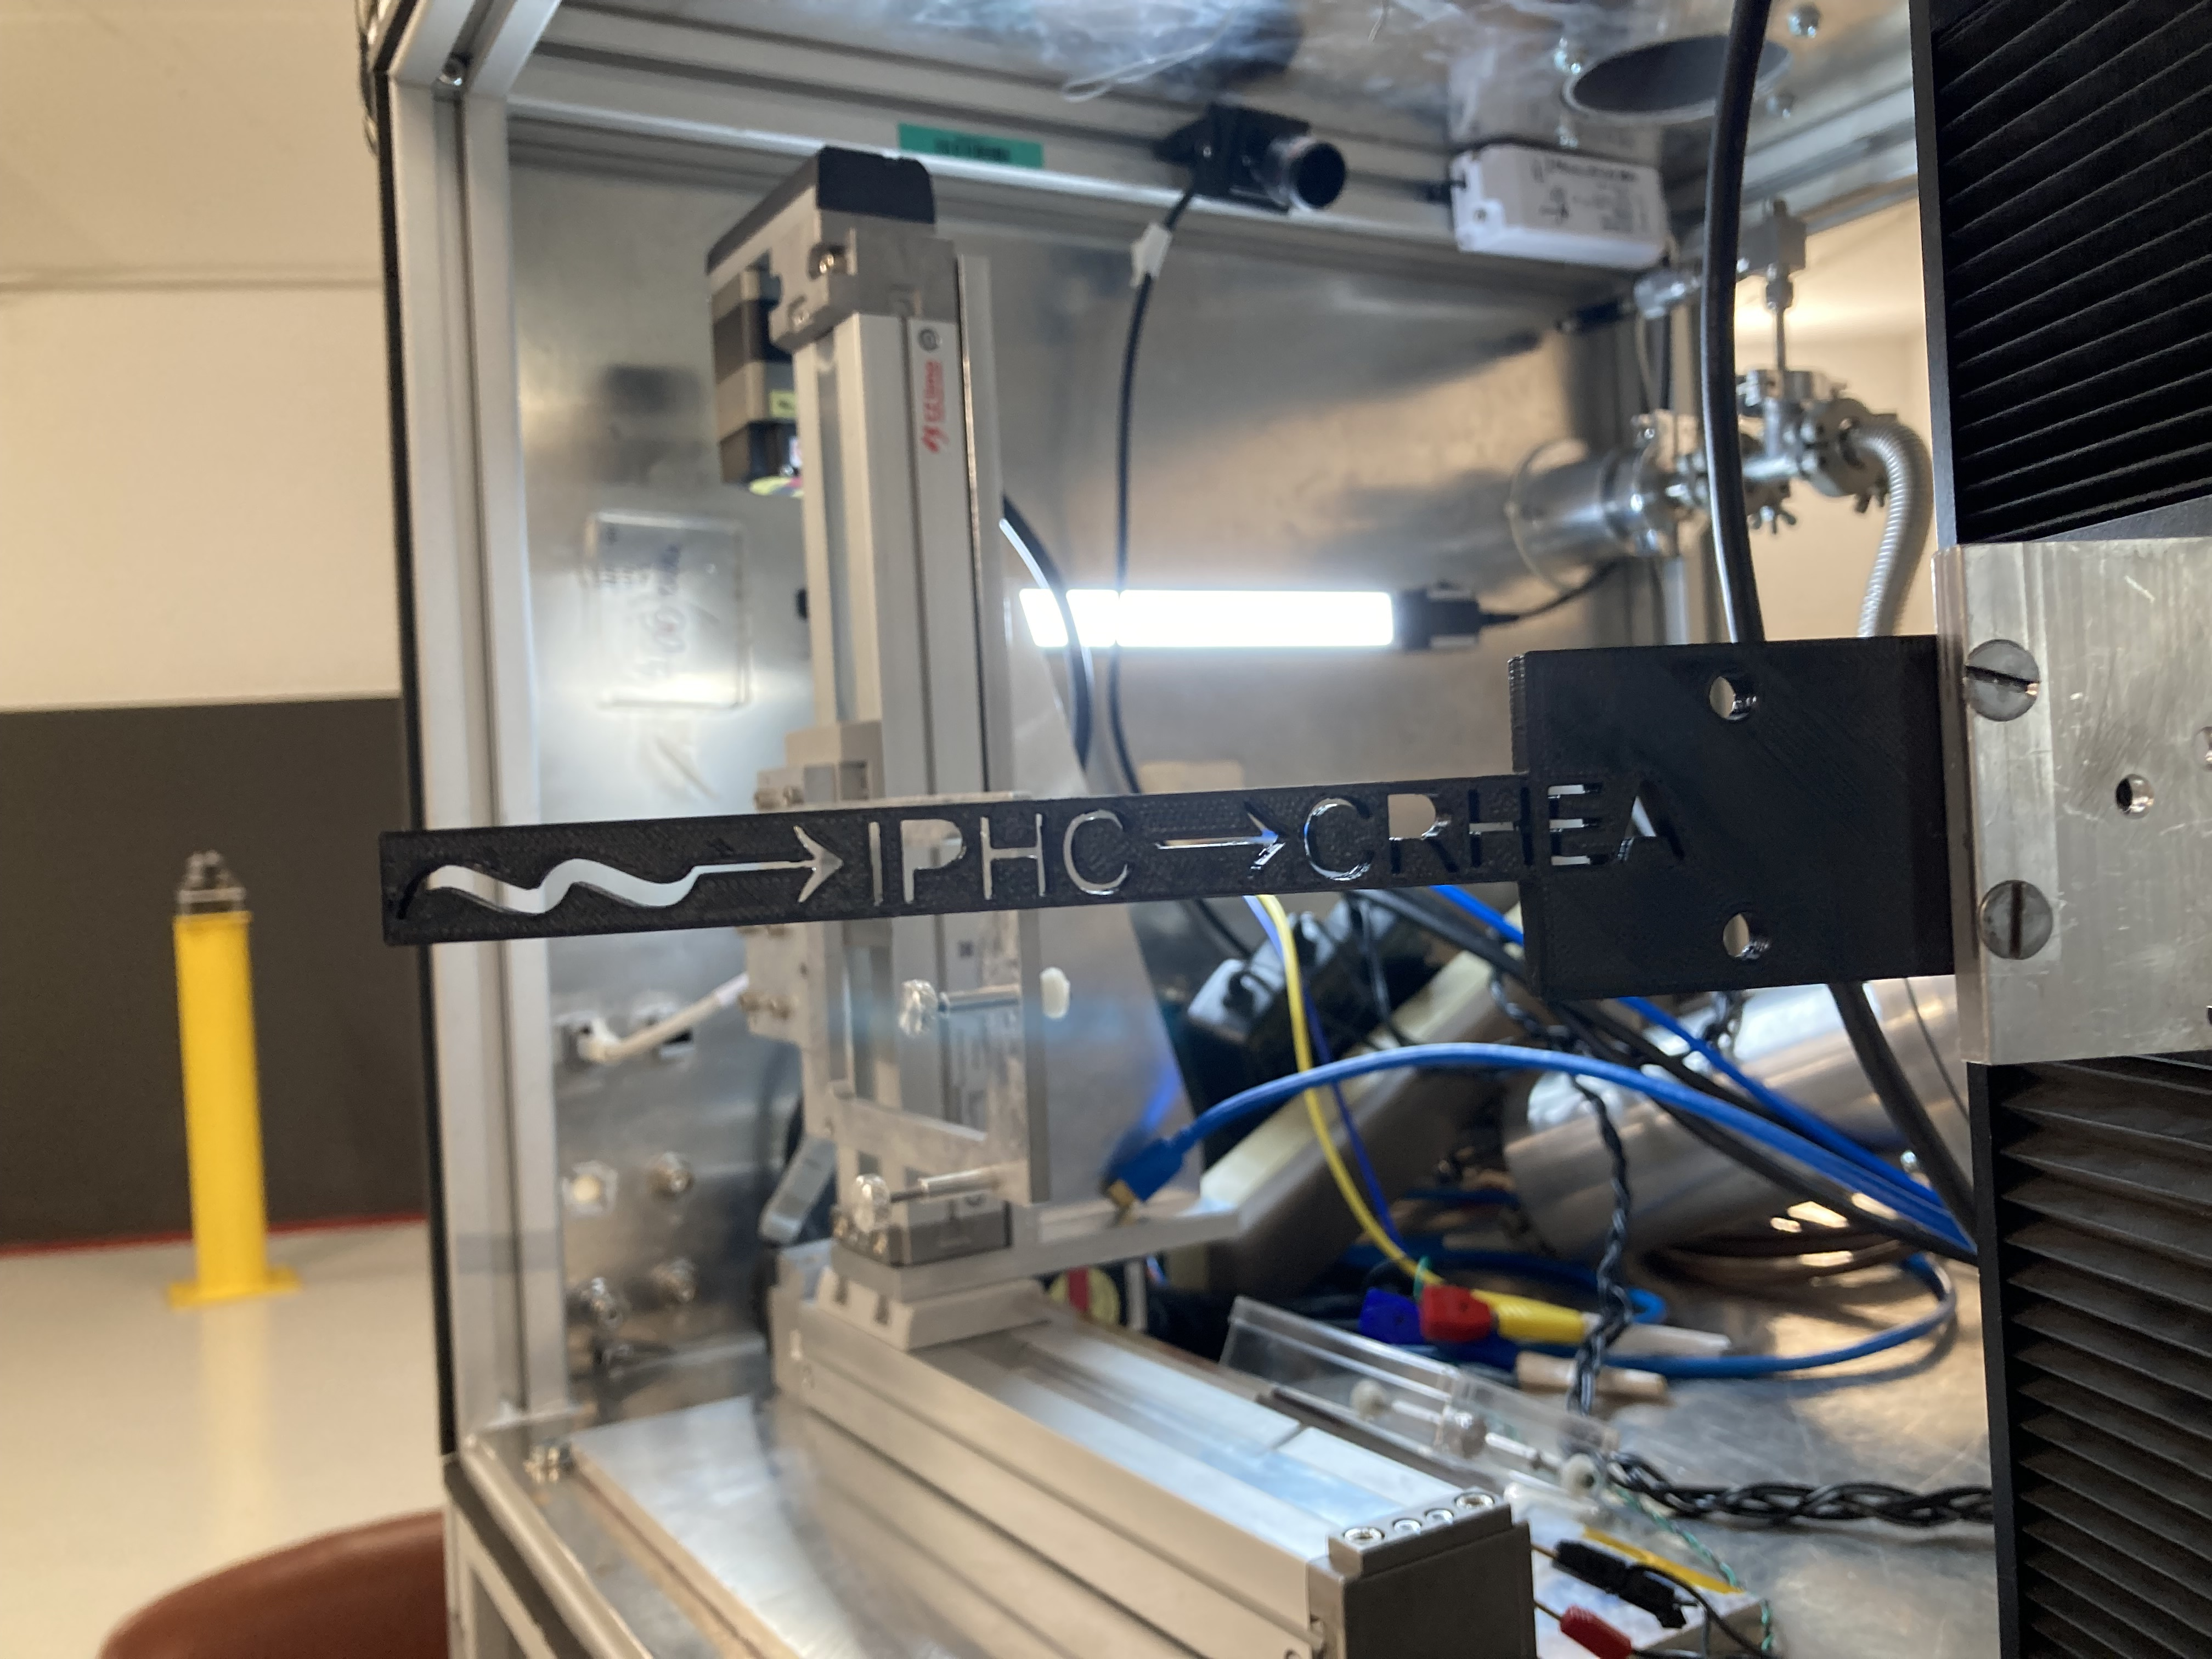
Movie Logo move
The following happened around/ during the movie:
Planned was an x-translation (photo) but this was not possible due to the extent of the linear stage over the vacuum box
The change to y-worked mechanically, but the code was not ready for it. Somehow the controller has a factor 2 on this y-axis stage, which was not considered.
From design the movie is reversed: Meaning we started with the end of the logo and ended the movement at the intended start of the movie.
Thus we started the linear movement far too late and moved far too wide with the y-stage.
We only have the IPHC fully in the movie, CRHEA is cut on the first letter (I will not interfere in this Strasbourg – Nice thing here ☺)
But the start of the movie shows (for a relatively long time) how the stage moved into the 2 limits and broke them… - live documented!

Slide 22
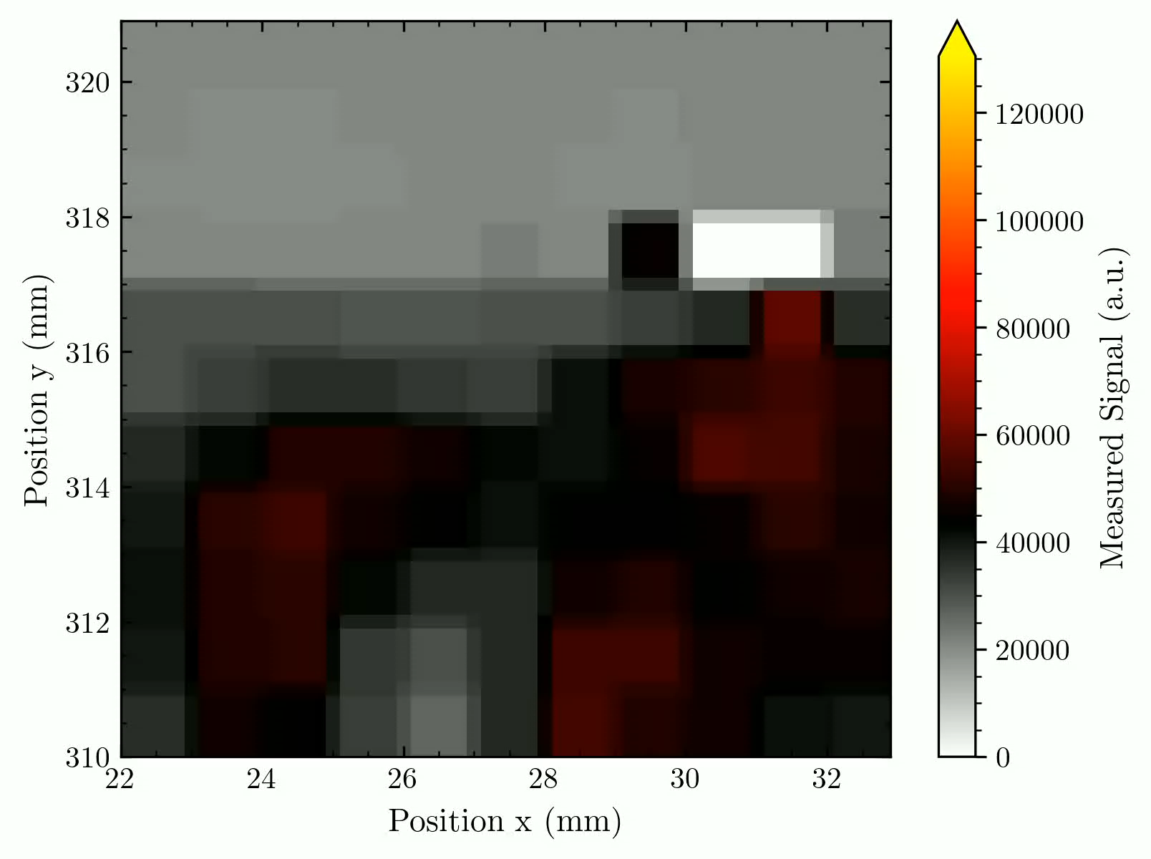
I still need to compensate for the not working pixels, normalize everything, and mirror the image (since it‘s false from this perspective).
Some other remark: The logo was too thin and thus did not absorb the proton beam. We thus have a contrast from red (protons with lower energy) to grey (open proton beam). And some density fluctuations in the logo make parts harder to recognize.

Slide 23
General remarks

Slide 24
General stuff
Logbooks will be scanned and made available for you.
We need to discuss conferences/papers, as we already talked about with Matilde, Maxime & Stéphane.

Slide 25


Some plot-style remarks (from your side?)
I can quickly change the colour scale, format, etc. , of my result plots (made with Matplotlib). So if you have some remarks or suggestions, … please let me know. Maybe we can discuss some uniform plot styles we use in the MATRIX project.
E.g.: I can put every colour scale for the intensity of our images/videos. I suggest some perceptually uniform scales as described by https://seaborn.pydata.org/tutorial/color_palettes.html
(I try to avoid the quite often used rainbow scale because of the green part that's recognised more by the eye.)
It is also possible to design any colour scale on our own by just handing Matplotlib the colours it should vary in between.
Some examples: These two are uniform and avoid light or dark shades that could vanish before a background.

